Slide 1
Kent Wimmer Senior Northwest Florida Representative and Coordinator of the Northwest Florida Sentinel Landscape November 9, 2022
Defenders of Wildlife

Slide 2
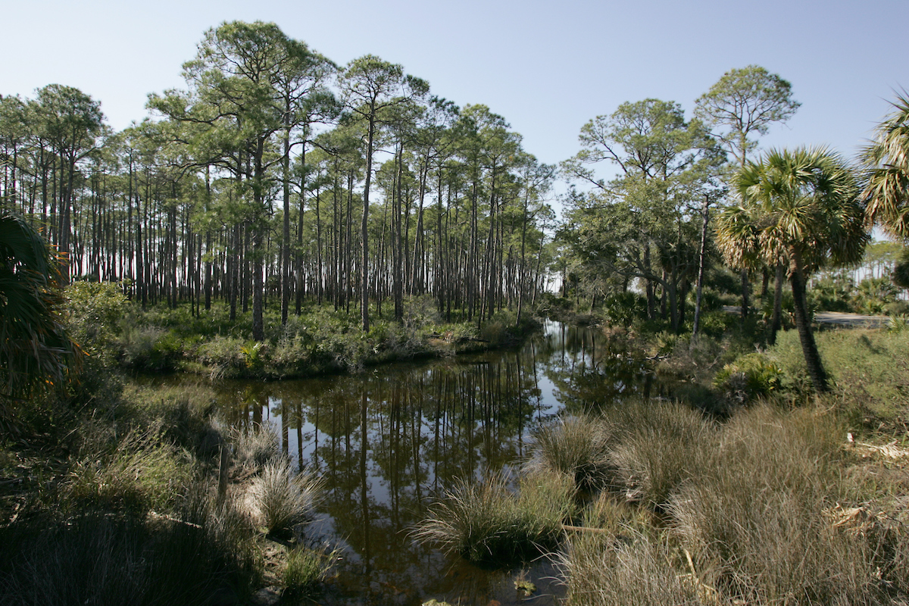
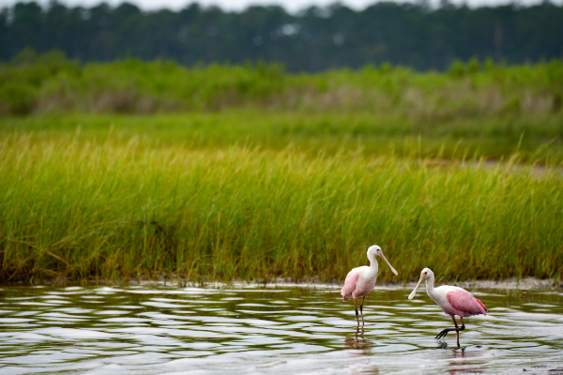
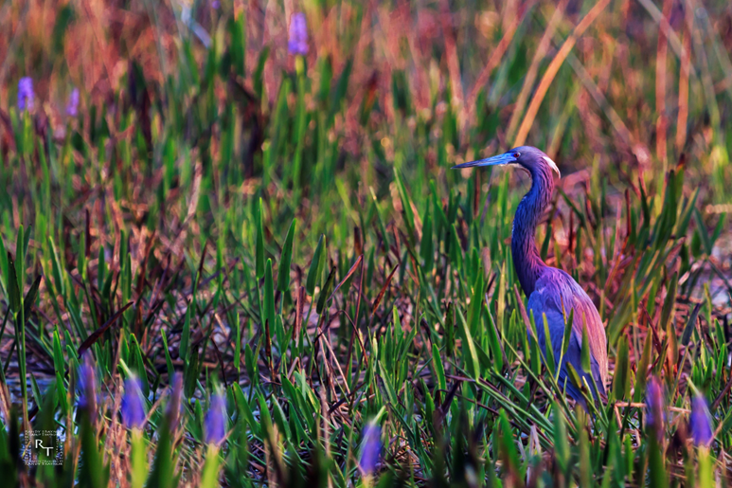
Roseate spoonbills
St. Marks NWR
Tidal creek
St. Marks NWR
Tricolor heron
Notes:
Good afternoon. I’m Kent Wimmer. Thank you for the opportunity to introduce our work in Northwest Florida. Defenders works in Northwest Florida because we still have the opportunity to conserve its outstanding biodiversity and habitat. 1000 new residents move to Florida each day leading to land use change and development threatening habitat, forests and farms and the missions of our military installations.
In this presentation, I will:
describe what a sentinel landscape is
introduce you to Northwest Florida and the goals of our sentinel landscape partnership, and
highlight Defender’s leadership role for the Northwest Florida Sentinel Landscape.

Slide 3
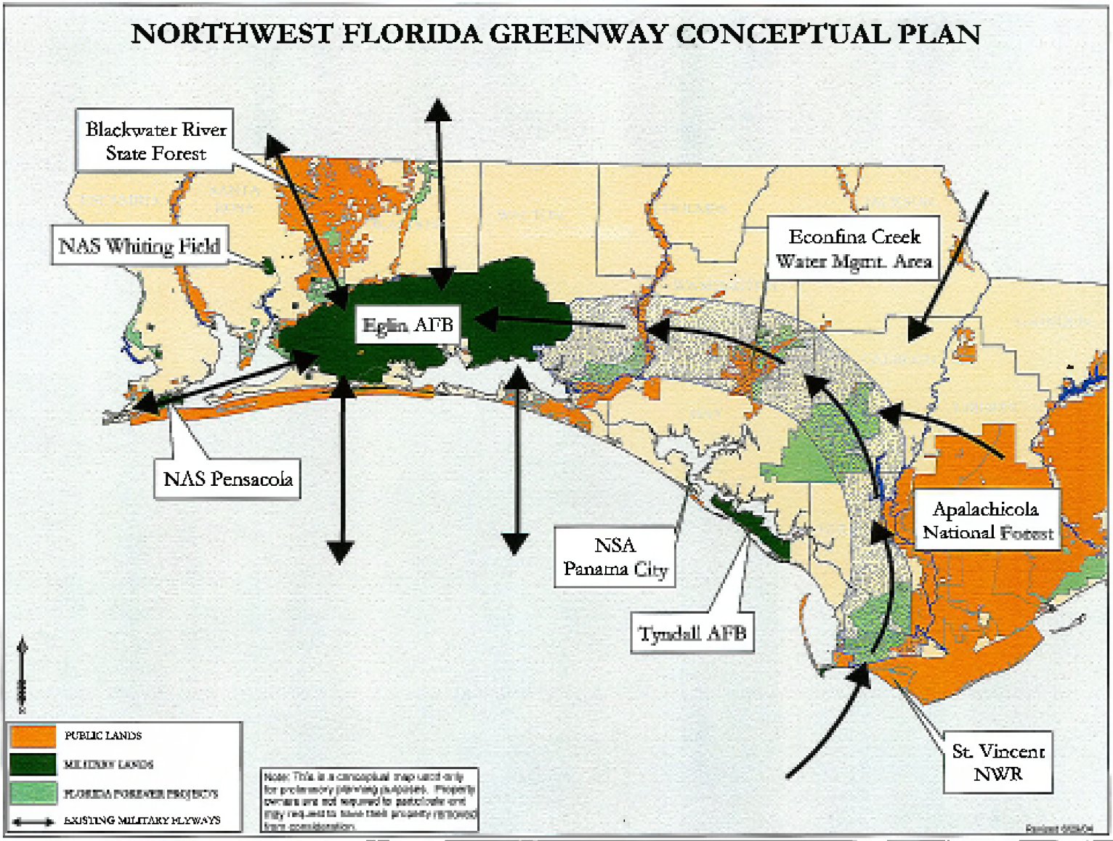
Notes:
In the early 2000’s, the Northwest Florida Greenway was envisioned to inspire agencies and organizations to work together to conserve the land under the military flyways between Eglin and Tyndall Air Force Bases and the Gulf of Mexico. The Northwest Florida Greenway was one of the inspirations for the national Sentinel Landscapes program.

Slide 4
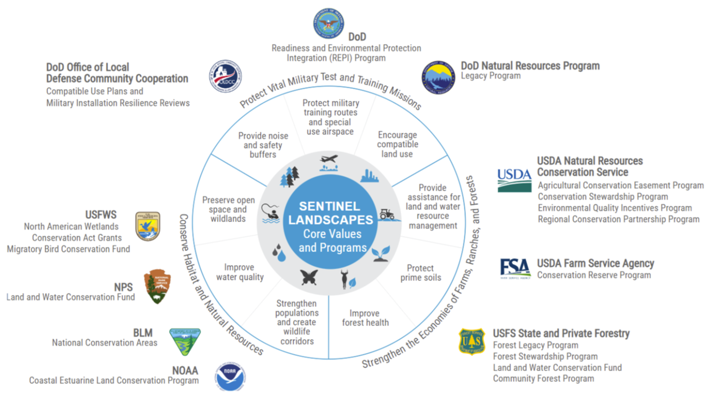
Notes:
In 2013, a coalition of federal agencies and non-governmental organizations formed the Sentinel Landscapes Partnership. Their goal is to foster collaboration with private landowners “to strengthen military readiness, conserve natural resources, bolster agricultural and forestry economies, and increase climate change resilience.” Leading the Sentinel Landscapes Partnership are Department of Defense through its Readiness and Environmental Protection Integration Program, the Department of Agriculture through the Natural Resources Conservation Service and the Forest Service, and the Department of the Interior’s Fish and Wildlife Service.
Sentinel Landscapes are bringing together partners who value the opportunity of achieving more significant conservation results through collaboration rather than by pursuing independent actions and projects. These partnerships are developing collaborative funding proposals for large-scale, multiple partner coordinated projects and programs rather than many small-scale projects. The Sentinel Landscape designation fosters coordination and can help proposals within Sentinel Landscapes be more competitive and successful in securing funding. Through establishing a collective vision for each sentinel landscape, partners can see how their organizations’ efforts fit into and complement regional priorities for conserving habitats, retaining working lands and protecting military missions.

Slide 5
Please visit sentinellandscapes.org to learn more.
Notes:
By 2017, seven Sentinel Landscapes had been designated across the nation. That year, at the invitation of the Air Force with support of the Fish and Wildlife Service, Defenders and our allies in Northwest Florida began to build a partnership to seek federal designation of Northwest Florida as a sentinel landscape. The process took longer than we anticipated, but in February 2022, the Sentinel Landscapes Partnership formally designed the Northwest Florida Sentinel Landscape.
Northwest Florida is one of only ten sentinel landscapes in America. Because of Florida’s strong commitment to the military and to land conservation, our state is the first with two federally designated sentinel landscapes – the Avon Park Air Force Range in south central Florida and Northwest Florida. These sentinel landscapes represent of dozens of partners.

Slide 6
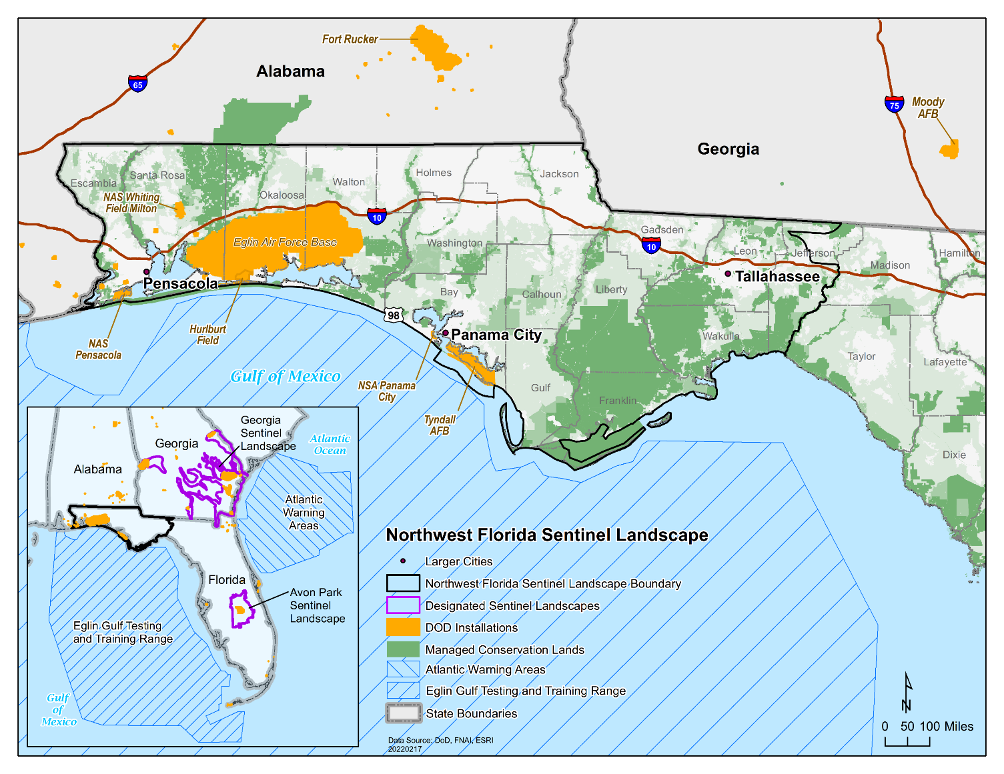
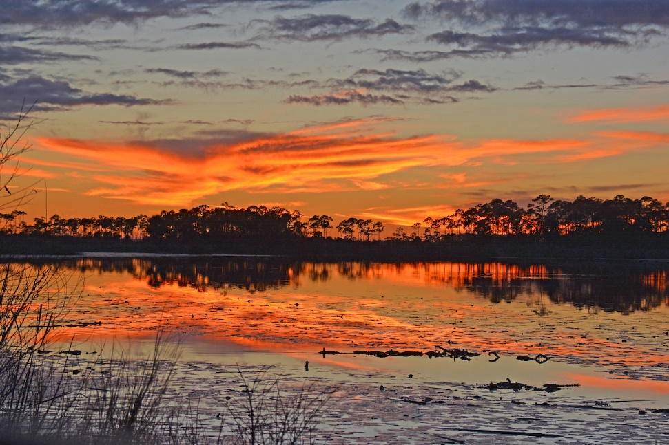
St. Marks NWR
Please visit the Northwest Florida Sentinel Landscape page at sentinellandscapes.org to learn more.
Notes:
This map shows the boundary of the Northwest Florida Sentinel Landscape which captures the entire Florida panhandle from Pensacola in the west to Tallahassee in the east. On this map military installations are shown in yellow, existing public and private conservation lands are in dark green, areas proposed for conservation are medium green, and areas suitable for conservation are in light green.
Our sentinel landscape is supported by a partnership of over four dozen federal and state agencies, non-governmental organizations, regional coalitions and private landowners.
Our partnership is working to retain working lands, conserve wildlife habitat and protect military testing and training missions in Northwest Florida. We are doing this by implementing conservation and restoration projects that bolster mission resilience, and by providing sustainable social, environmental and economic benefits to our local stakeholders.

Slide 7
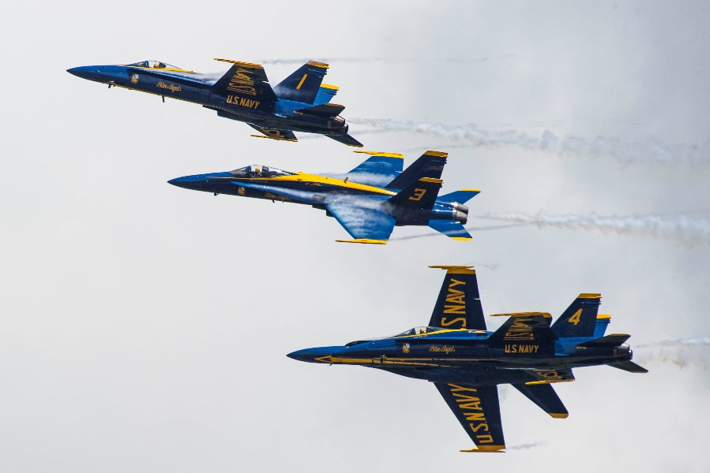
Blue Angels
NAS Pensacola
Notes:
The 16-county Northwest Florida Sentinel Landscape has hosted military bases since Spanish colonization. It is home to six of the nation’s most important Air Force and Naval Air installations and ranges spanning 165 miles along the northeastern Gulf of Mexico coast. These installations include:
Eglin and Tyndall Air Force Bases
Hurlburt Field
Naval Air Stations Pensacola and Whiting Field and
Naval Support Activity Panama City
These installations are vital to our national defense because of their training and weapons testing missions. As you can see on the map, with the military flight paths in purple and operations area in light blue, most of Northwest Florida is within a military mission footprint. These installations have direct access to the Eastern Gulf of Mexico Testing and Training Range. This range is larger than all other ranges inside the continental United States combined. This military range is why there is no oil drilling off Florida’s Gulf Coast.
The Blue Angels, pictured here, are based at Naval Air Station Pensacola. The Blue Angels will have their final air show of the year this coming weekend in Pensacola.

Slide 8
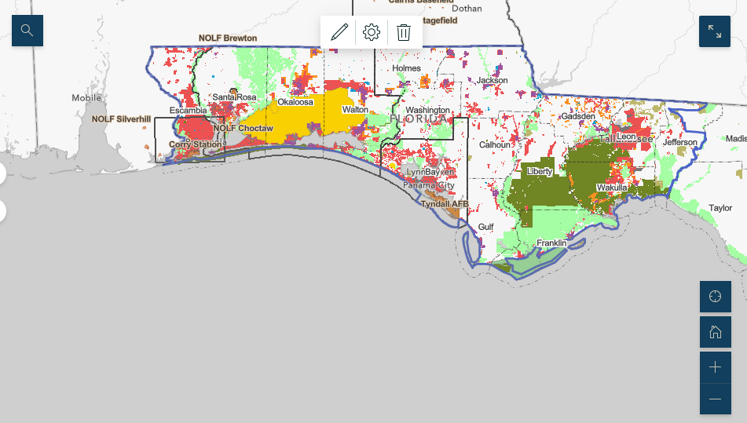
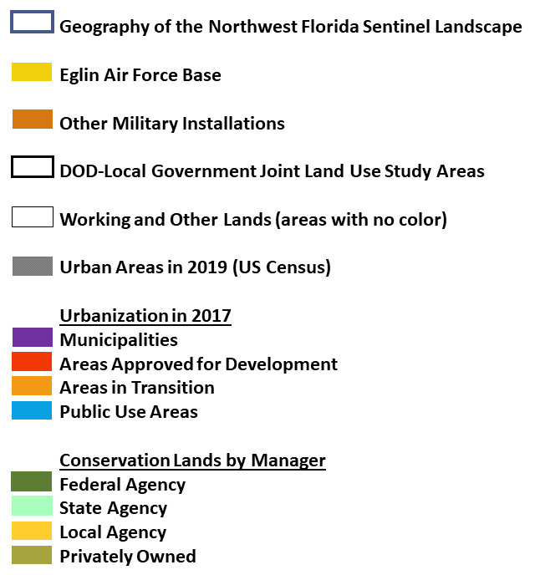
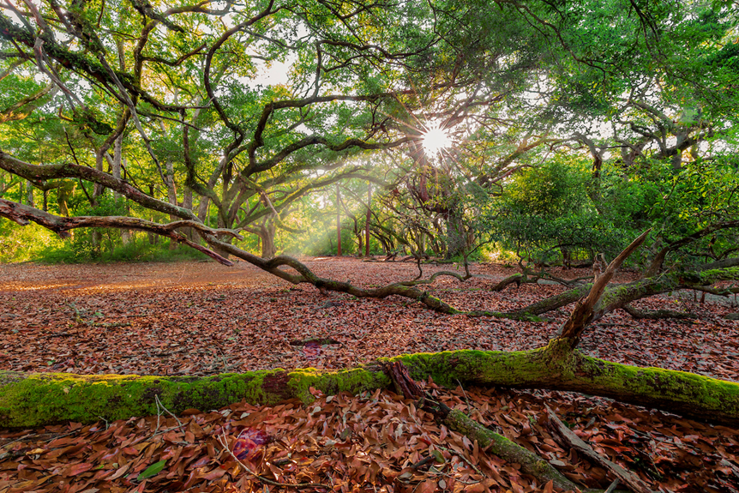
Apalachicola NF
Notes:
This map shows the existing conservation lands in shades of green and yellow with existing urbanization shown in red, orange and purple.
Most of the 11,000 square-mile region is dedicated to agriculture and forested working lands. Over 4,000 square miles, or more than 2.6 million acres, have been protected in 75 tracts of public and private conservation lands managed by sentinel landscape partners.
These lands include the St. Marks and St. Vincent National Wildlife Refuges, the Apalachicola National Forest, and Gulf Islands National Seashore. Northwest Florida also has dozens of state parks, forests, wildlife and water management areas that help conserve a dozen river corridors. Over 200,000 acres of private lands are conserved in the region concentrated in the Red Hills area north of Tallahassee, along the Apalachicola River and in Nokuse Plantation east of Eglin Air Force Base.

Slide 9
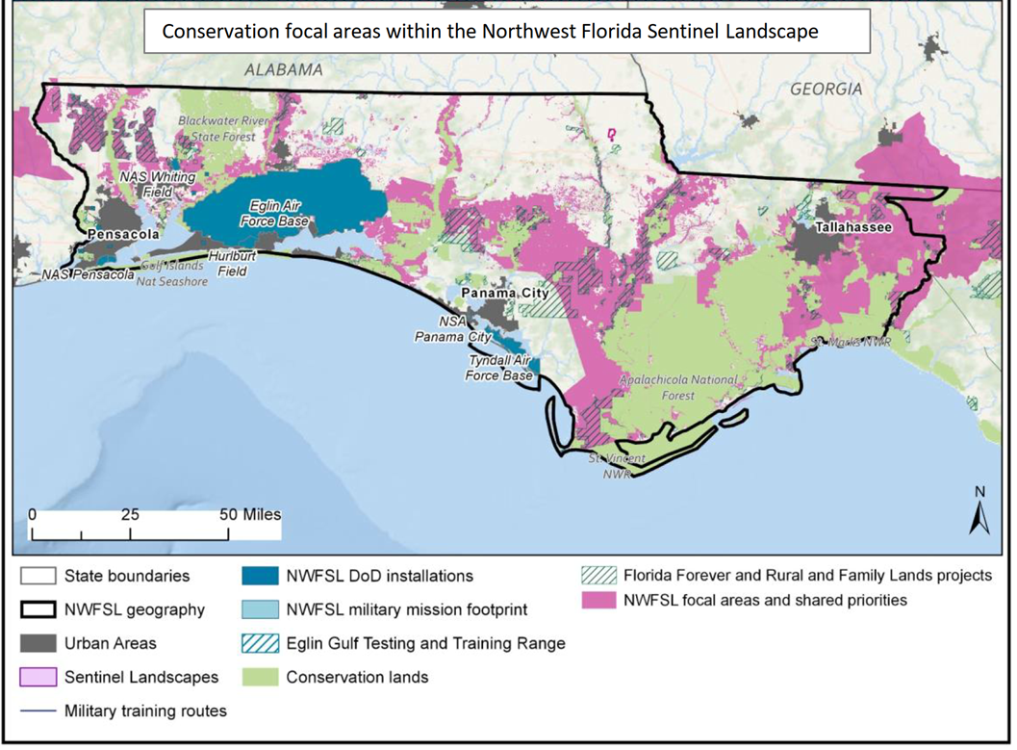
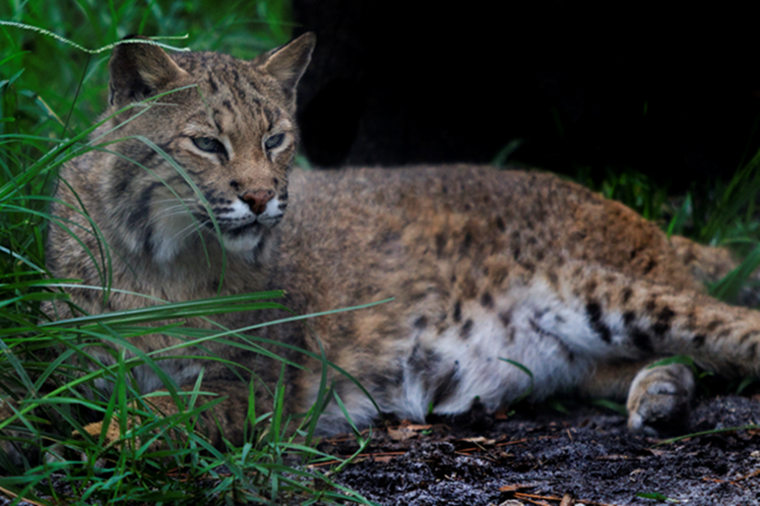
Bobcat
Notes:
A key strategy for our sentinel landscape is to conserve a connected network of wildlife habitats. These greenway corridors extend east and west across Northwest Florida and follow the dozen north and south river corridors connecting upland habitats to their Gulf of Mexico estuaries. Landscape-level conservation is essential for listed species recovery and for working lands to persist despite the threats of climate change and land use conversion. This map shows our partners’ priority or focus areas, including the Florida Wildlife Corridor shown in pink, which connects conserved lands shown in green and the military installations shown in blue. Lands targeted by the state for conservation are shown in the green crosshatch.

Slide 10
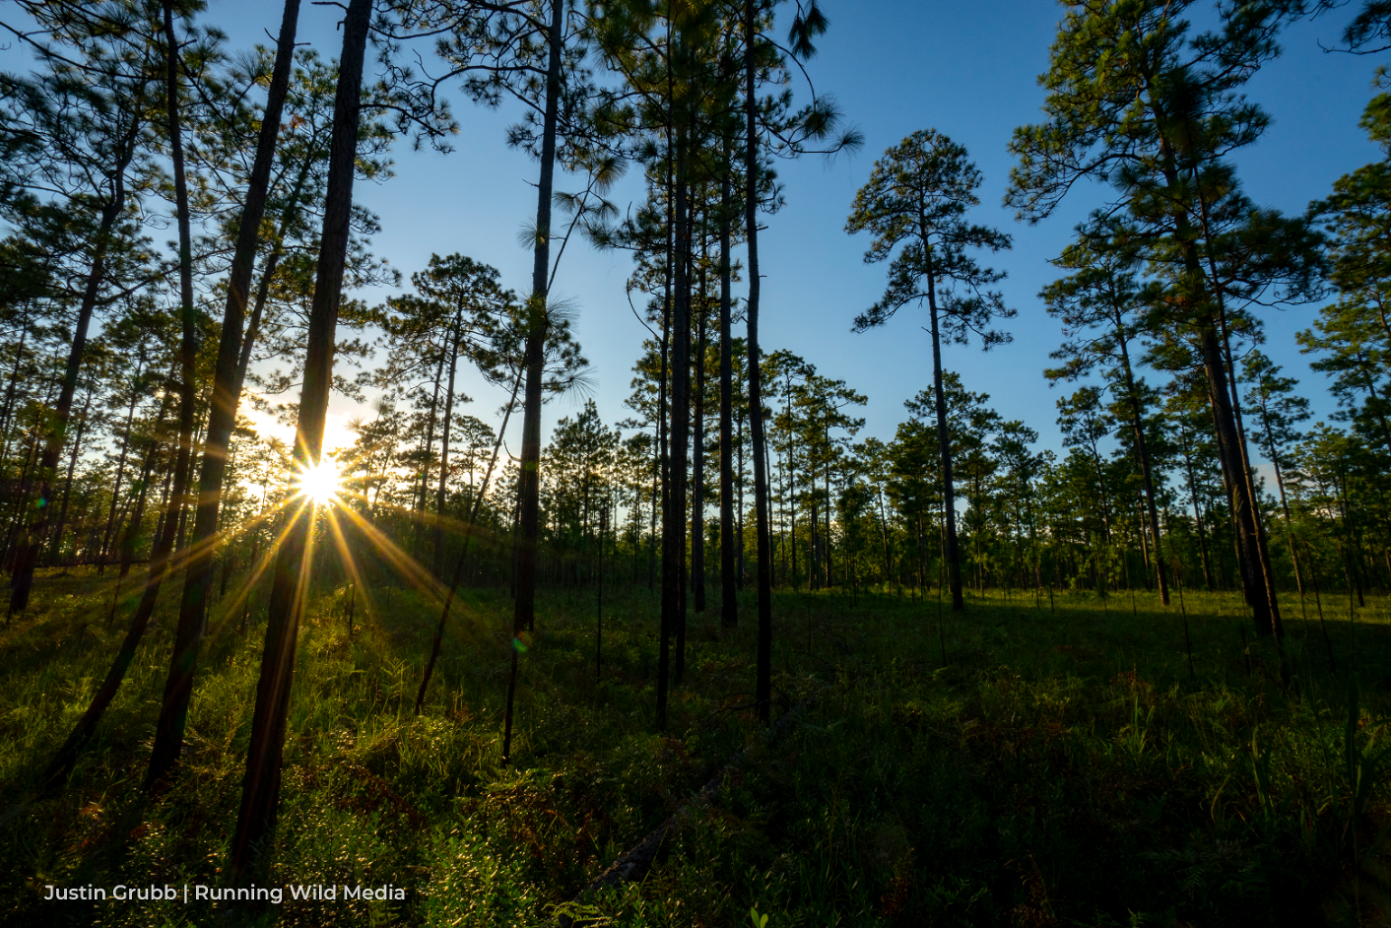
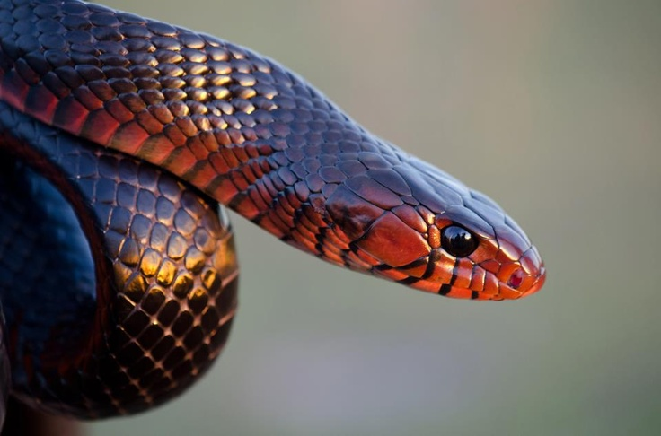
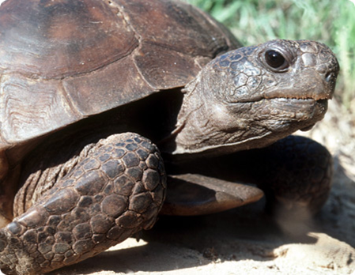
Longleaf pine
Red Hills
Eastern indigo snake
Gopher tortoise
Notes:
Northwest Florida is home to 29 Federally Endangered, 20 Threatened, and one Candidate species. These include the red-cockaded woodpecker, Eastern indigo snake, two species of flatwoods salamanders and numerous other federal and state listed species such as the gopher tortoise.

Slide 11
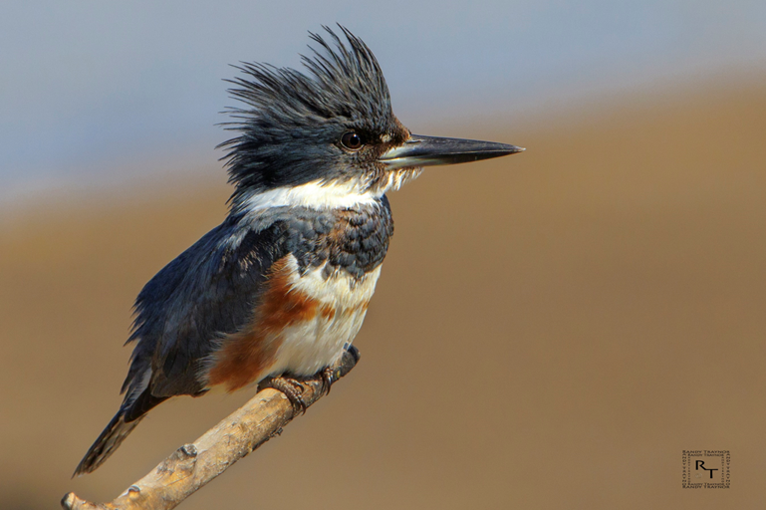
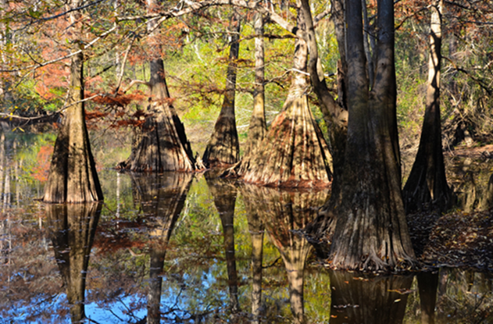
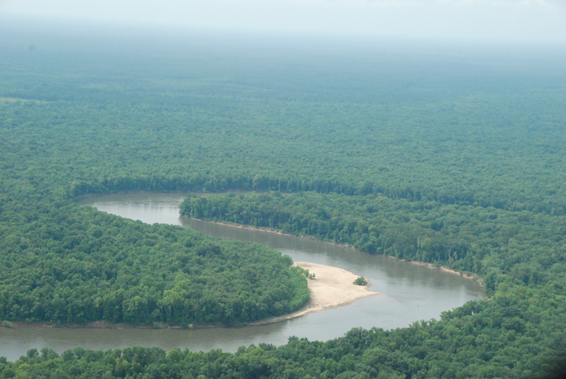
Bald cypress
Apalachicola River
Kingfisher
Apalachicola River and floodplain
Notes:
The Apalachicola River with its floodplain and adjacent steephead ravines is one of North America’s most biologically diverse areas. It has the highest species diversity of reptiles (over 80 species) and amphibians (over 40 species) found north of Mexico. It also provides habitat for more than 280 species of birds, more than 130 species of fish, 52 species of mammals, and more than 1,300 plant species including over 70 different species of trees.

Slide 12
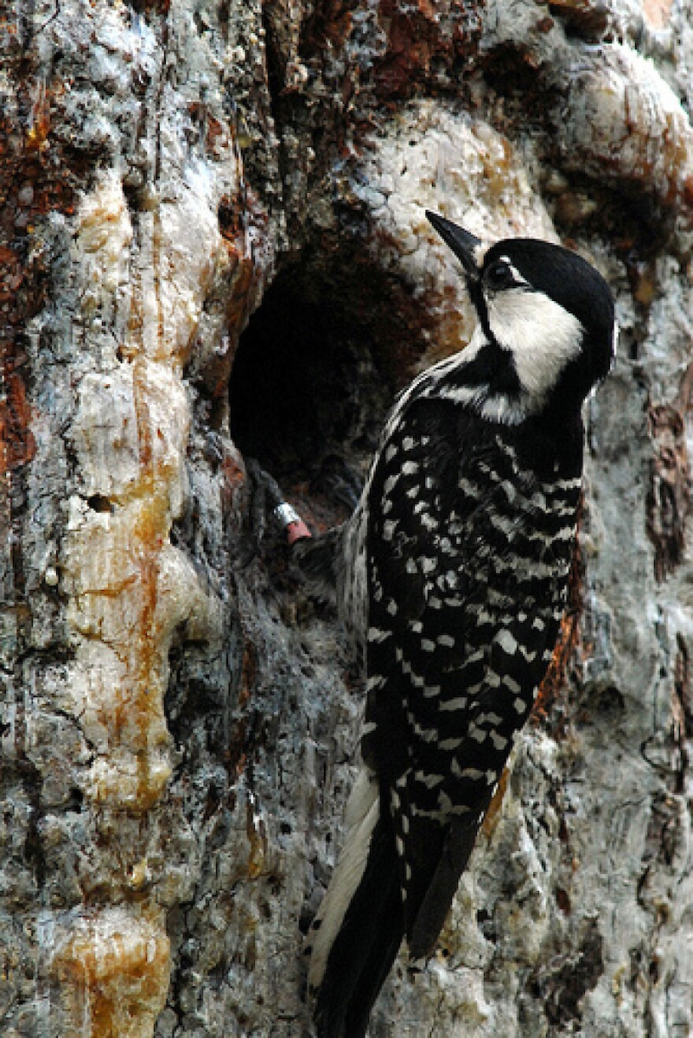
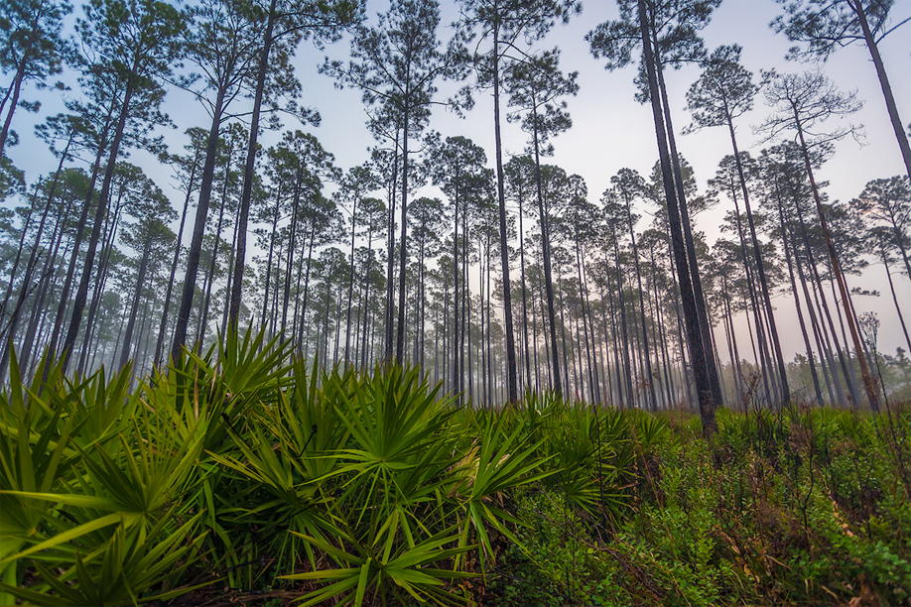
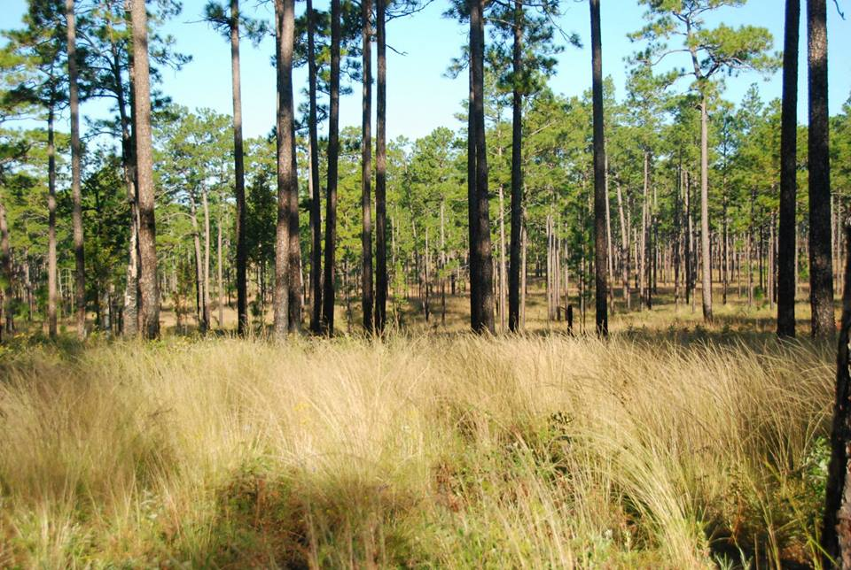
Long leaf pine &
sawtooth palmetto
Apalachicola NF
Red –cockaded
woodpecker
Longleaf pine and wiregrass
Red Hills
Notes:
Restoring habitats and maintaining connections between public and private conservation lands are critical. Thriving and recovering populations of listed species on non-military lands provides potential to reduce the regulatory burden associated with on-installation training and testing. For example, the successful stewardship in the Apalachicola National Forest and the Red Hills ensures two of the largest remaining populations of the endangered red-cockaded woodpecker will continue to thrive outside of Eglin Air Force Base.
Nokuse Plantation and Eglin Air Force Base are working to restore gopher tortoise populations, which along with state regulation, contributed to the Fish and Wildlife Service not listing its eastern population as a Threatened species. The Air Force has also partnered with the Fish and Wildlife Service to restore habitat for the formerly endangered Okaloosa darter whose 95% of its entire range is found on Eglin Air Force Base. This partnership allowed the Okaloosa darter to be removed from the Endangered Species list.

Slide 13
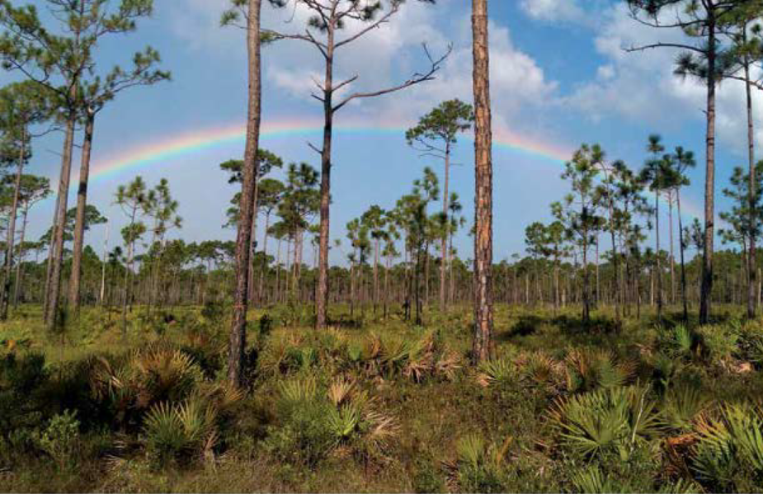
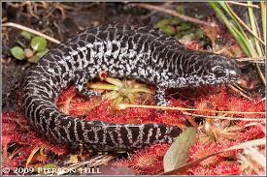
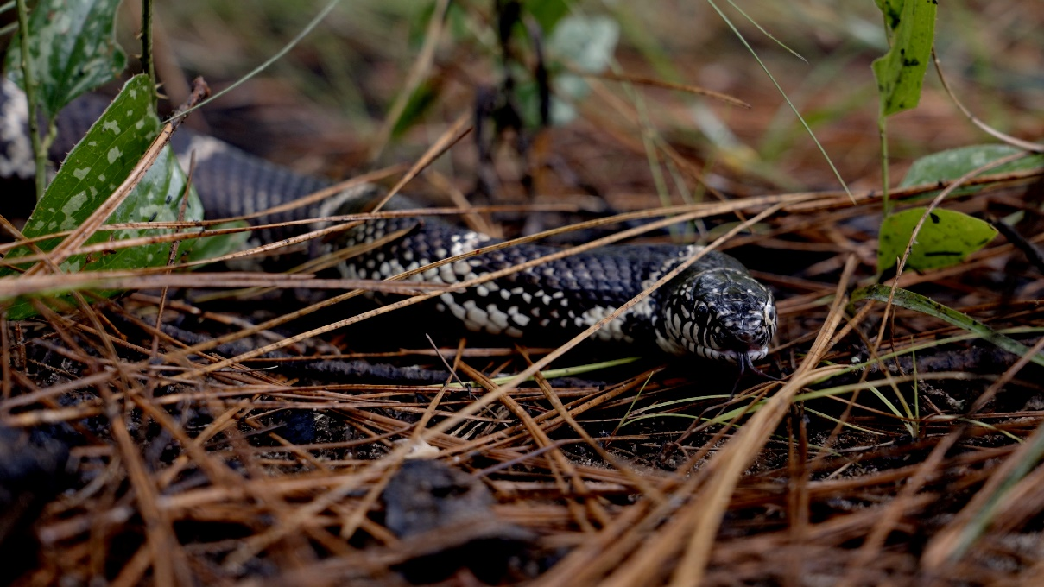
Reticulated flatwoods
Salamander
Eglin Air Force Base
Eastern king snake
Tall Timbers
Notes:
The region’s longleaf pine forests and the riverine ecosystems provide important habitat for many sensitive species. Northwest Florida is home to some of the nation’s largest remaining stands of longleaf pine. Eglin Air Force Base has the largest contiguous old growth longleaf pine forest in existence, plus it has the largest intact sandhill ecosystem in the Southeast. Over 1.5 million acres are conserved in the eastern portion of the sentinel landscape. Northwest Florida also has extensive industrial pine forests with thousands of acres being restored with longleaf pines.

Slide 14
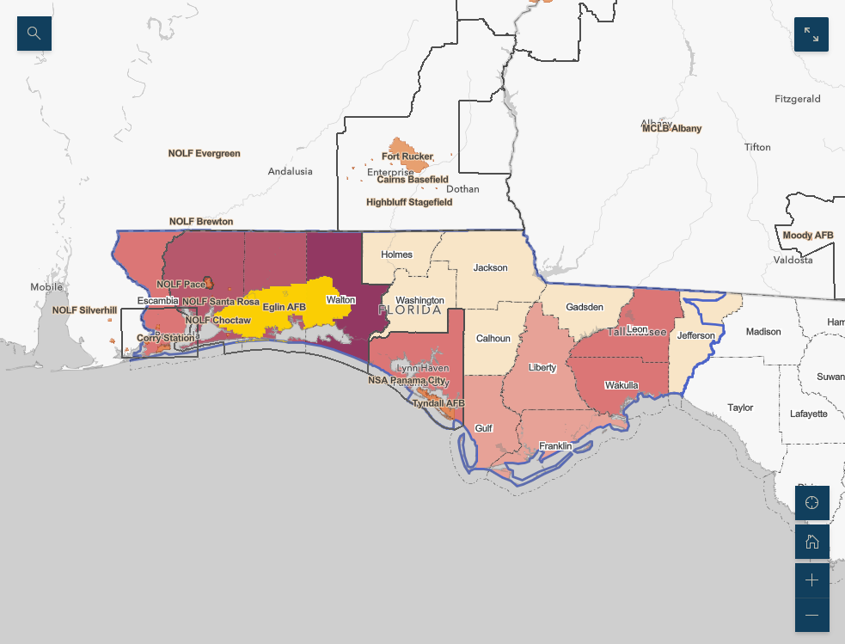
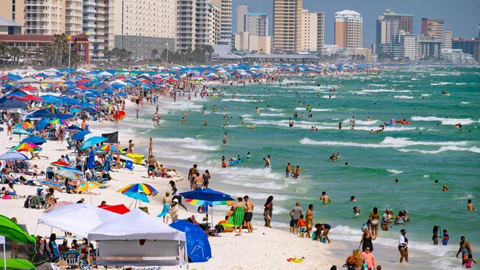
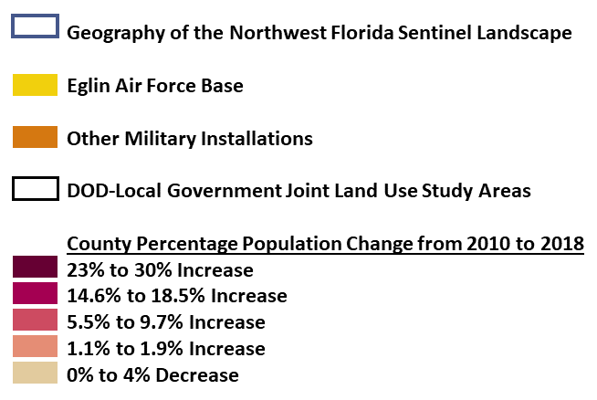
Panama City Beach
Notes:
The opportunity still exists in Northwest Florida to create a network of lands to conserve watersheds, wildlife habitat, working lands, to provide outdoor recreation opportunities, and to the support the missions of Northwest Florida’s military installations. Primary challenges facing our installations and natural communities are impacts from climate change and land use change due to population growth.
But these opportunities may be fleeting. This map shows between 2010 and 2018, the populations of the five counties home to the six principal military installations increased between 6 and 30 percent. Development can limit the use of prescribed fire, hinder wildlife movement, and negatively impact surface and ground waters, and threaten estuaries on the Gulf of Mexico. Finally, development in the wrong places may threaten military missions. In 2020, the military represented nearly 29% of the total economy of Northwest Florida.

Slide 15
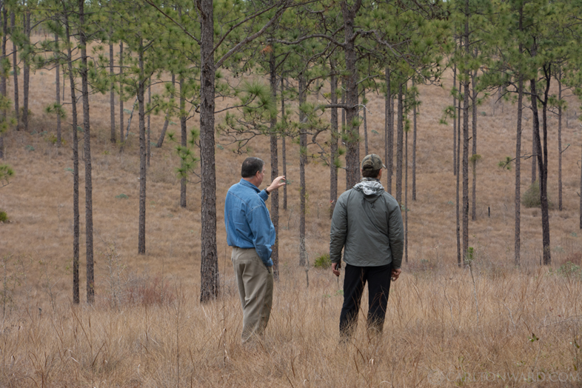
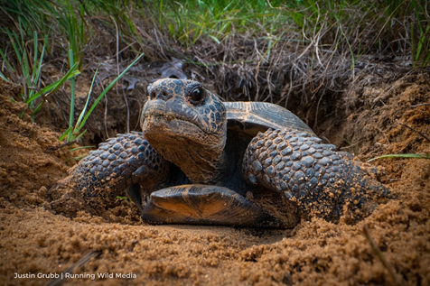
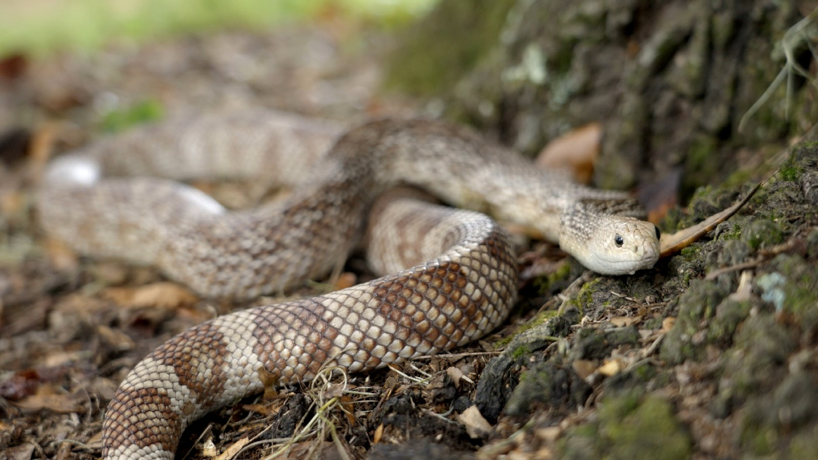
Longleaf pine & wiregrass
Econfina Creek WMA
Gopher tortoise
Nokuse Plantation
Pine snake
Tall Timbers
Notes:
Rapid population growth and tourist-oriented development along the Gulf coast have led to unprecedented landscape conversion. Changes in land use threaten the missions of our region’s military installations and the long-term sustainability of nearby forestry and agricultural operations.
Our collaborative effort seeks to keep forests and farms working through incentives and voluntarily participation in conservation funding programs of our partner agencies and organizations. These working lands are essential connectors between public and private conservation lands, military installations and ranges.

Slide 16
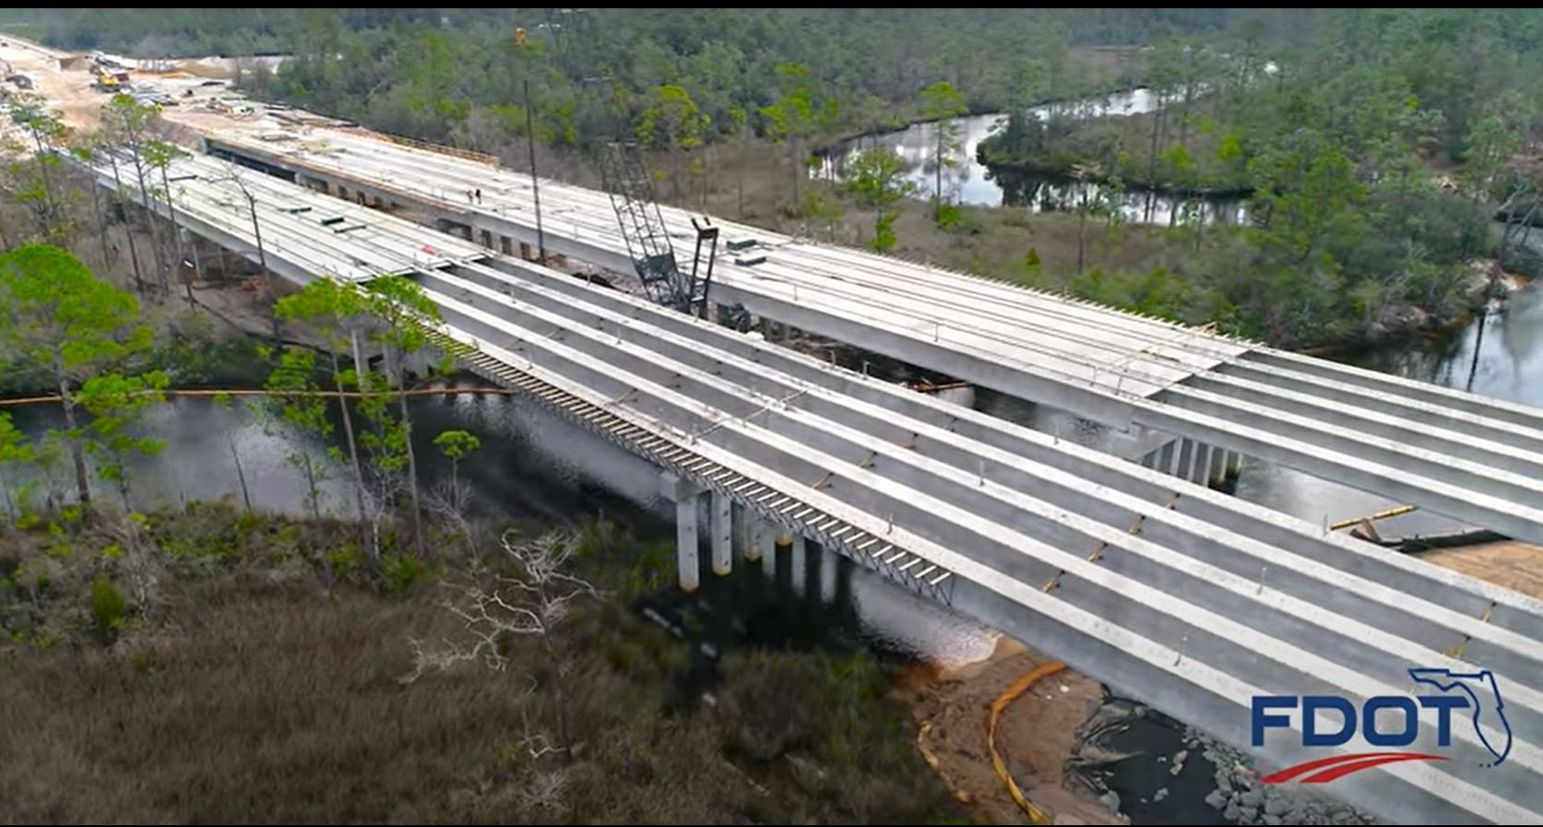
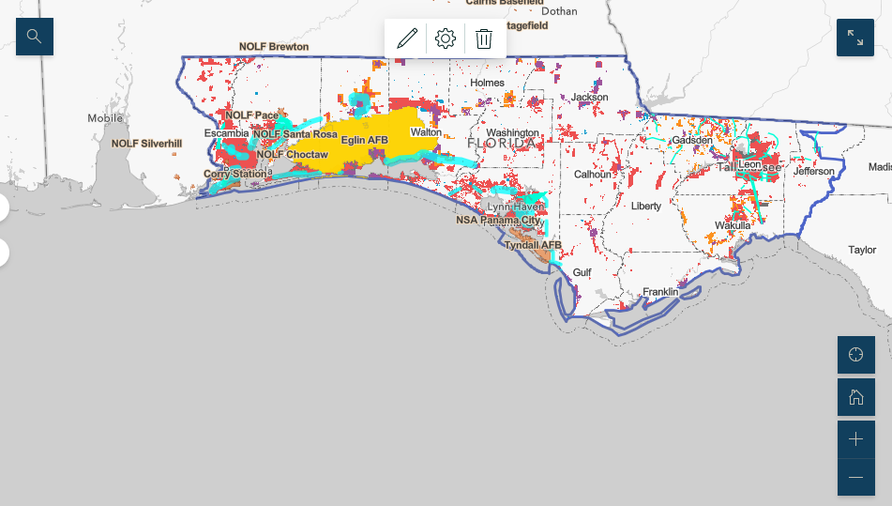
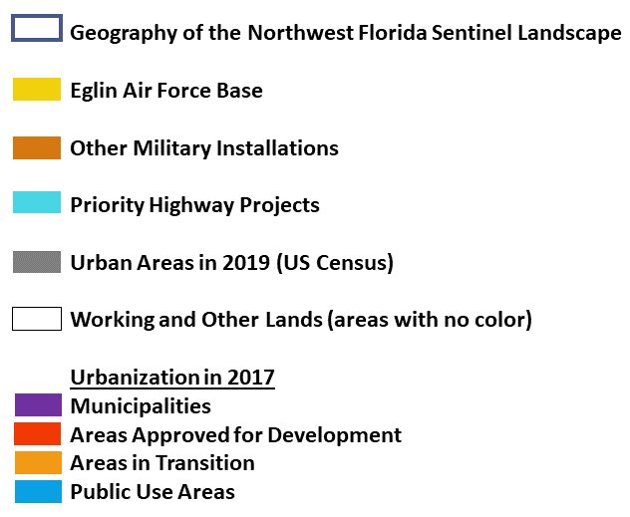
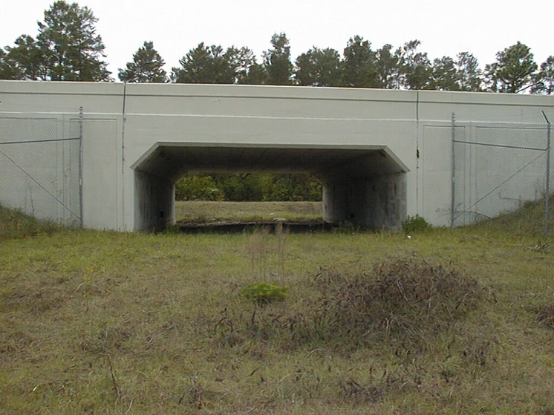
SR 388
Wildlife crossing
Notes:
In response to rapid population growth, state and regional transportation plans call for widening many highways and constructing new highways in coastal areas and near military installations. This map shows highway proposals as light blue lines and the urbanized areas in red, orange and purple. We coordinate with the Florida Department of Transportation and regional transportation planning agencies to avoid, minimize and mitigate impacts on conservation lands and advocate for the construction of wildlife crossings to minimize habitat fragmentation and to protect wildlife and motorists.

Slide 17
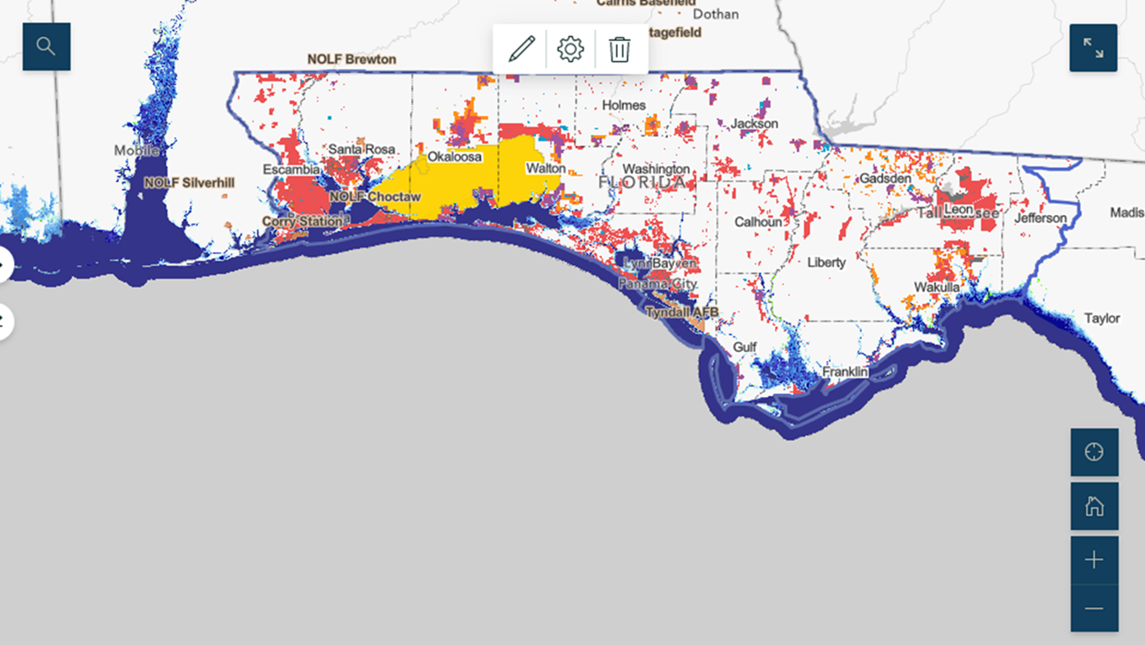
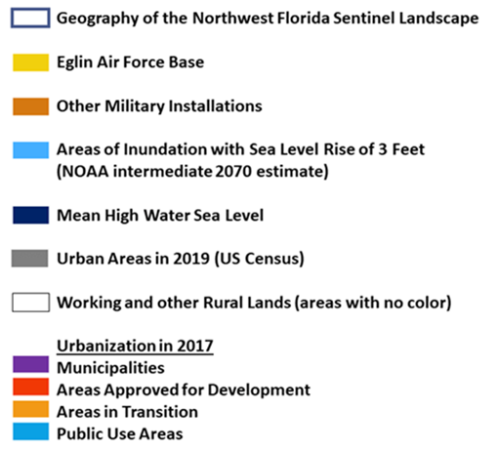
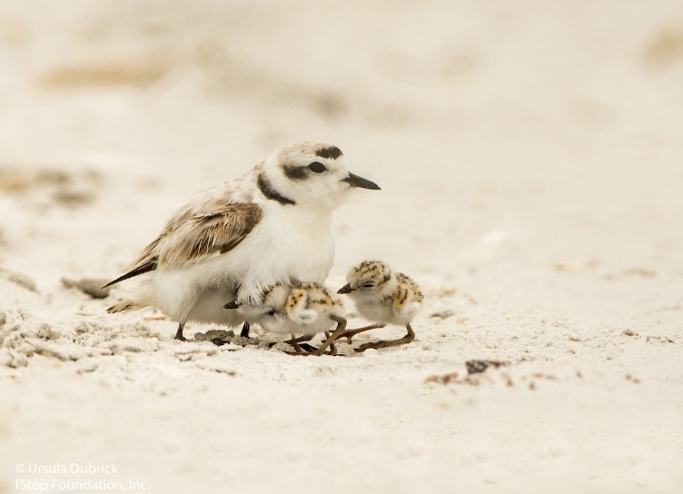
Snowy plover with chicks
Notes:
Compounding the impacts of land use change, climate change will significantly alter low-lying coastal areas threatening not only infrastructure, but also habitat of endangered and threatened species. Areas forecast to be inundated by 2070 are show in light blue on this map.
Extreme weather events, such as Hurricane Michael’s destruction of Tyndall Air Force Base in 2018, directly impacted national security by degrading its mission capabilities. It also diverted significant national defense resources with approximately $4.5 billion dollars being appropriated for Tyndall’s reconstruction.
Hurricane Michael also affected 2.8 million acres of timber lands in the heart of the sentinel landscape. With 80 percent of those lands owned by more than 16,000 private landowners, there is much uncertainty as to how much of the damaged forest land will be converted to a land use not compatible with low level Air Force training.
Increasing storm intensity and frequency heightens the urgency for regional collaboration to mitigate the effects of extreme weather, storm surge, sea level rise and coastal erosion on natural systems, infrastructure and military mission capabilities. Enhancing the resiliency of natural systems to our changing climate is a primary objective of our partnership.

Slide 18
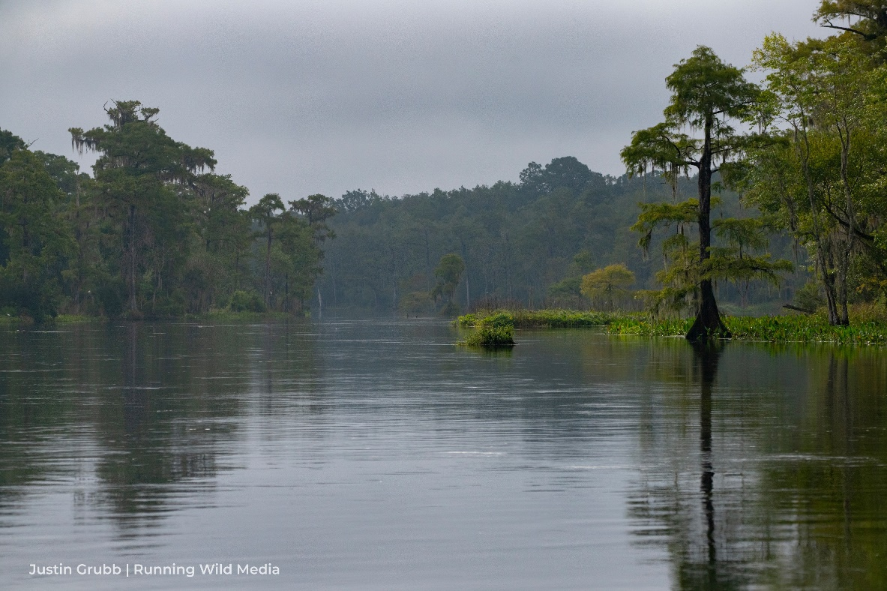
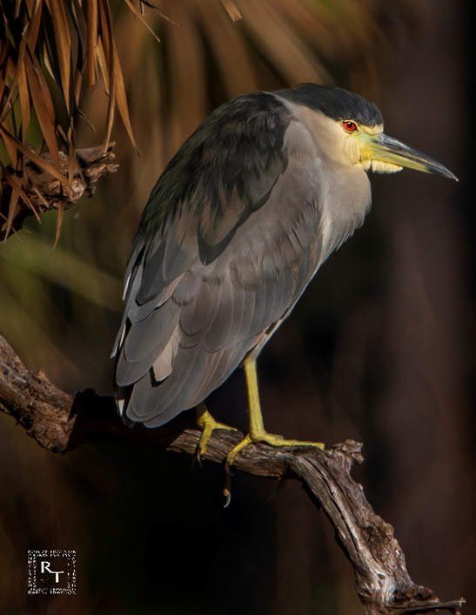
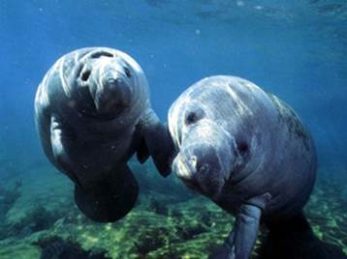
Wacissa River
Anhinga
Wacissa River
Black crowned
night heron
St. Marks NWR
West Indian manatees
Notes:
Defenders’ dedicated and sustained leadership has been essential for establishing and fostering this landscape conservation partnership in Northwest Florida.
In 2017, at the invitation of the Air Force, Defenders accepted the challenge to build support for a partnership to seek Sentinel Landscape designation. Defenders was well positioned to take this leadership role through my work advocating for landscape and habitat conservation in the region.

Slide 19
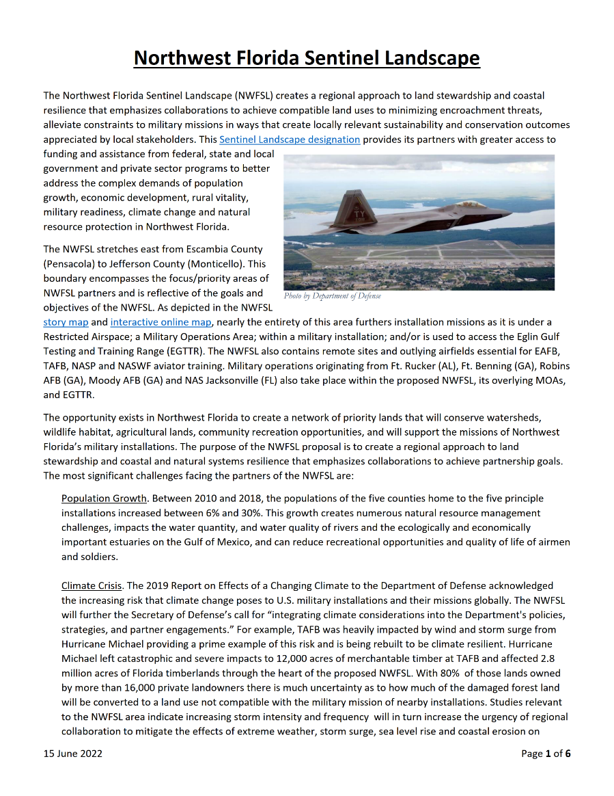
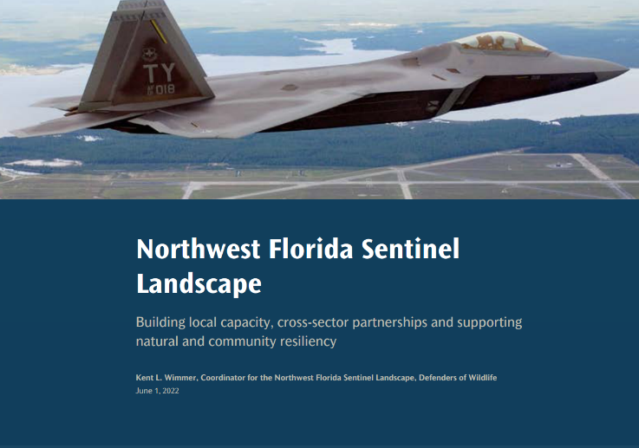
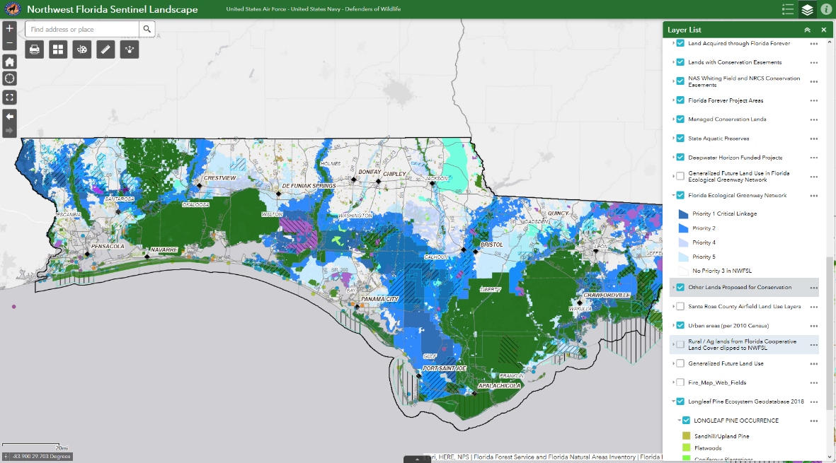
Story map
Factsheet
Web map app
Notes:
As we waited for a designation cycle to open each year from 2018 to 2021, Defenders maintained our partnership’s momentum. We continued to meet with prospective partners to introduce the Sentinel Landscape concept and to refine the focus for our partnership. We also refined the Sentinel Landscape boundary and created a factsheet. We developed an online web map application and story map to share our partners’ priorities, and the conservation opportunities and constraints in the region. These resources can be found on the Northwest Florida page at sentinellandscapes.org.

Slide 20
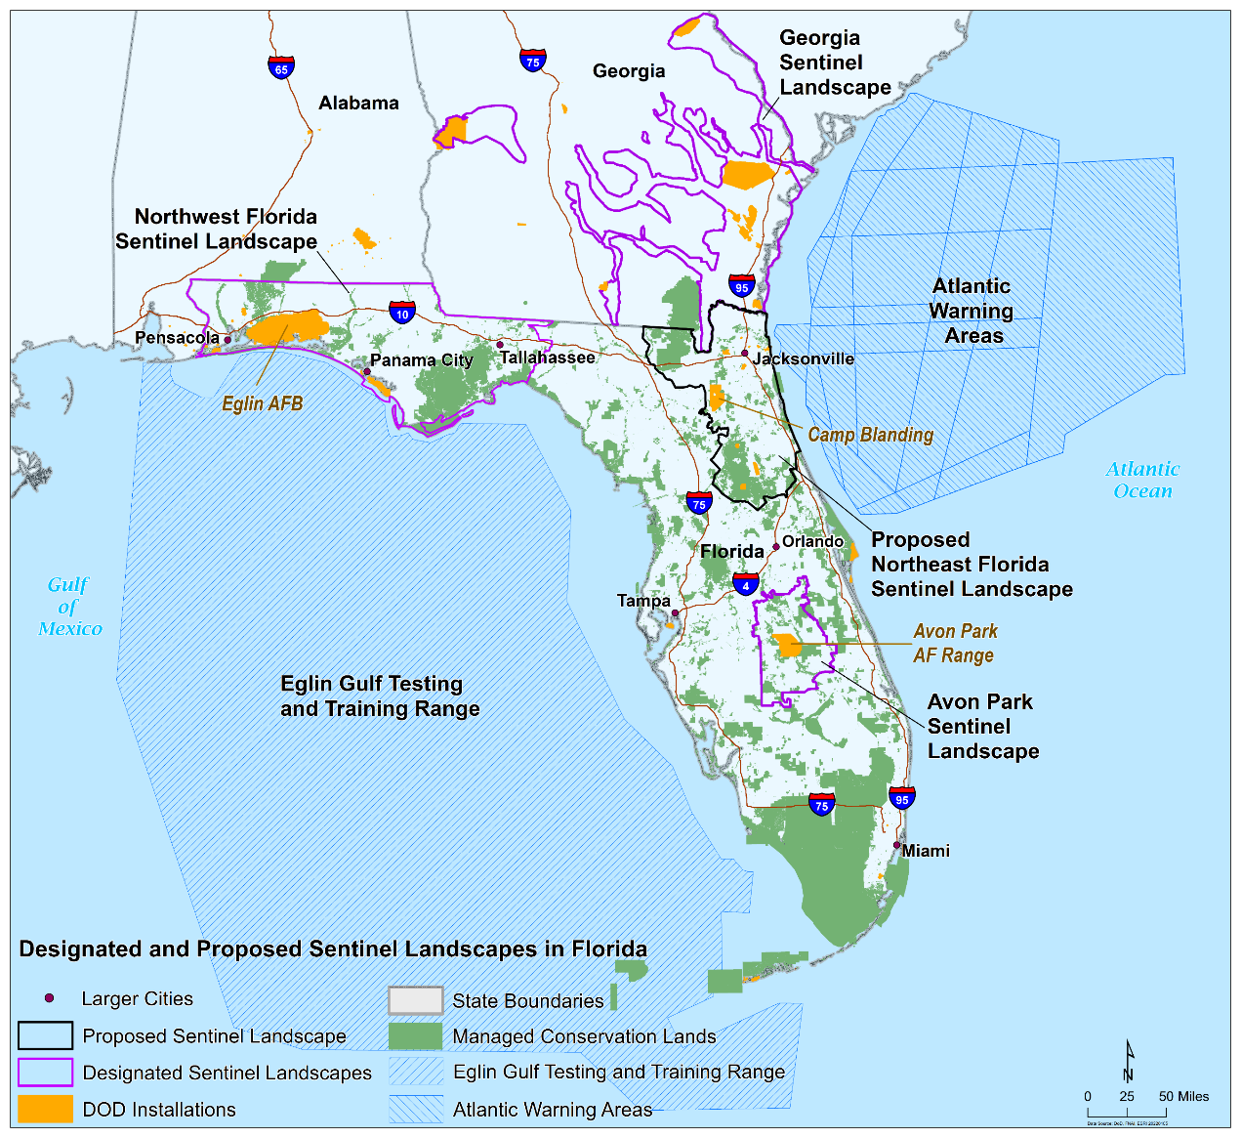
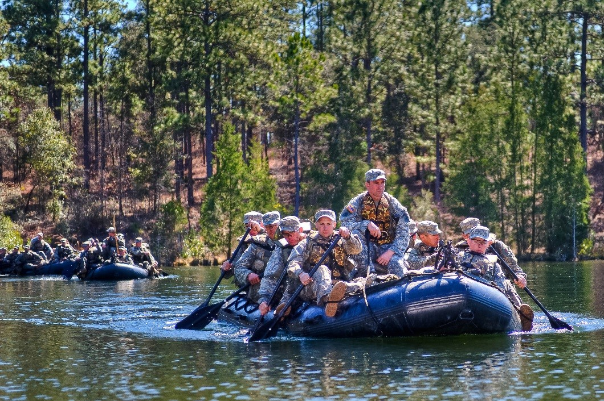
Army Rangers
Eglin AFB
Notes:
As part of our designation proposal, we needed to demonstrate how we would coordinate with statewide and national partners and other sentinel landscapes in Florida. Florida only already had an existing Sentinel Landscape—the Avon Park Air Force Range — and another proposed landscape — Northeast Florida — that was pursuing designation at the same time.
Defenders initiated a statewide partnership to explore and articulate how these landscape initiatives could coordinate and complement one another. These conversations culminated in January of this year with 25 parties executing the Sentinel Landscapes in Florida Memorandum of Understanding. This MOU provides an organized framework for federal and state agencies and non-governmental organizations supporting sentinel landscapes in Florida. We are using it to strengthen collaboration and streamline activities that connect private landowners around military installations with voluntary government assistance programs. Our MOU complements existing state legislation and programs to support and protect military installations. It is also a model for statewide coordination that other Sentinel Landscapes and states may consider.

Slide 21
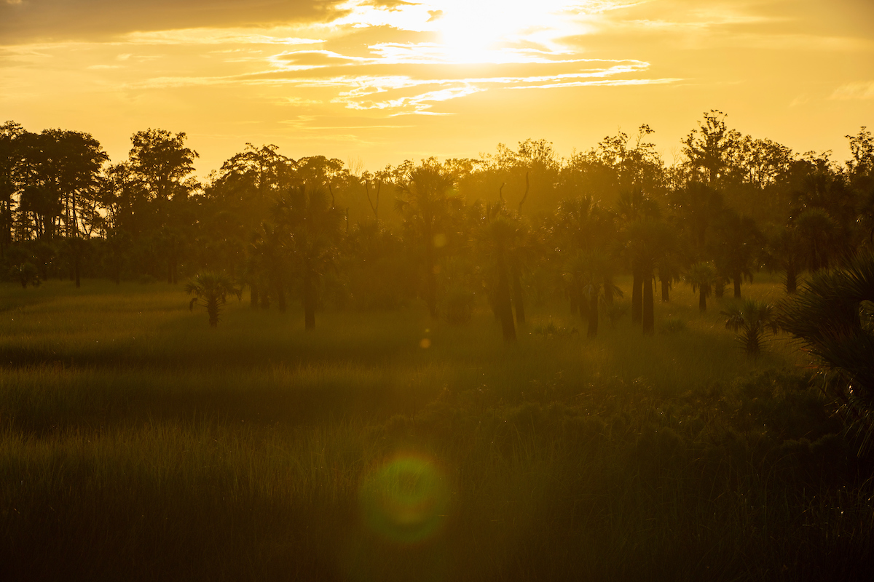
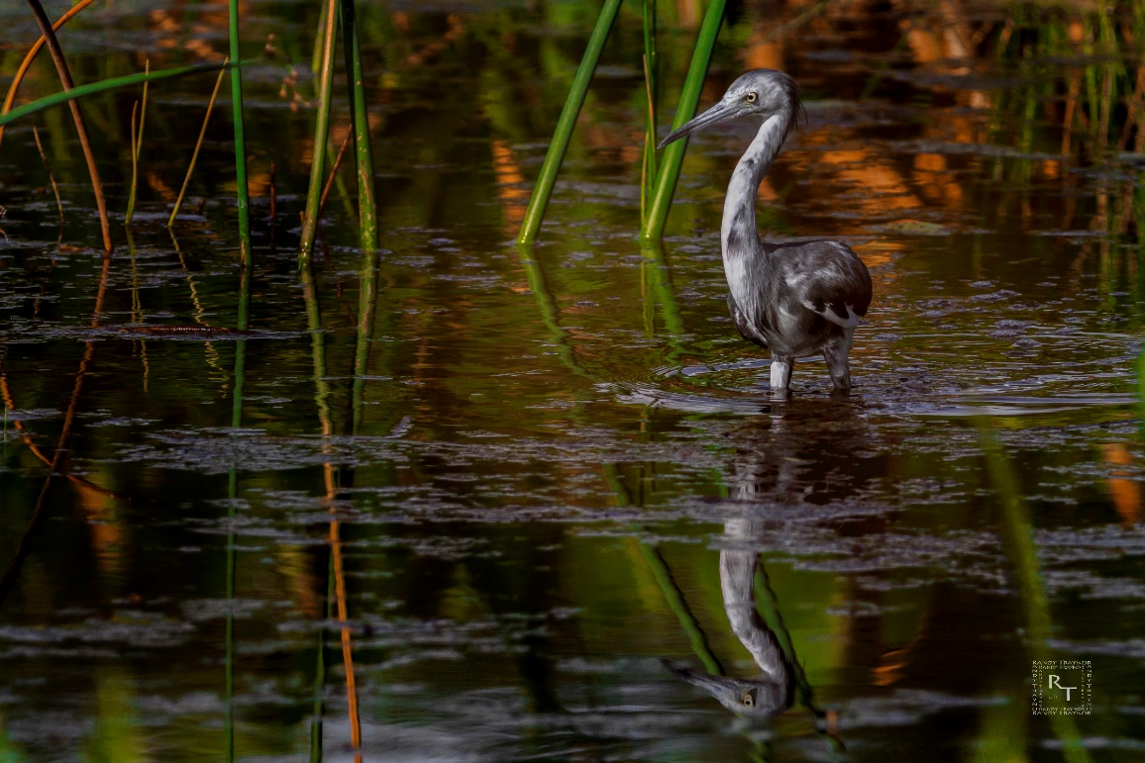
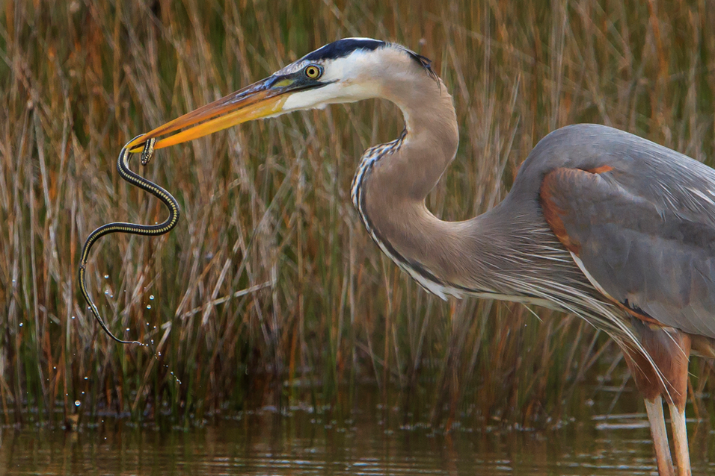
Saltmarsh
St. Marks NWR
Juvenile little blue heron
Great blue heron
St. Marks NWR
Notes:
The designation of the Northwest Florida Sentinel Landscape in this past February was the result of the Defenders’ significant investment and the commitment of our partners over the past five years.
Defenders’ consistent leadership enabled us to invest the necessary time to build and sustain relationships with our partners. It proved especially helpful as we navigated the Pandemic and waited each year for a designation cycle to open. Having a dedicated person within the landscape enabled us to recruit a broad coalition of partners to stand behind the designation when the Sentinel Landscapes Partnership finally accepted proposals in March 2021.

Slide 22
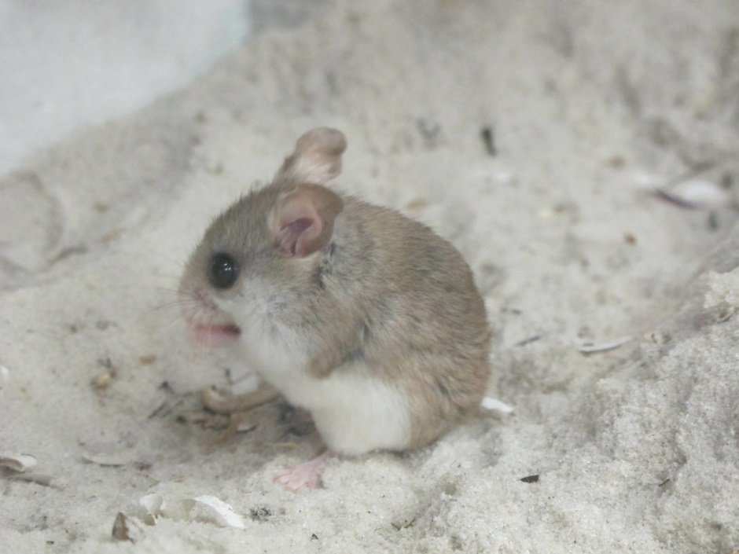
Coastal dunes
Perdido Key
Perdido Key beach mouse
Loggerhead sea turtle
Black skimmers
Notes:
As coordinator of the Sentinel Landscape, Defenders is committed to supporting our landscape partnership to advance our shared vision.
With the privilege of full-time coordinator, Northwest Florida is developing a more cohesive and effective partnership and a conservation delivery network. We are helping our partners better understand where priorities overlap so they may develop and submit collaborative proposals and keep up to date on the many conservation projects being pursued throughout the region.
Our partners have enthusiastically engaged because Sentinel Landscape designation provides them with greater access to funding, financial incentives and assistance from federal, state and local governments and private sector programs to accomplish their existing goals.

Slide 23
Tidal flats
St. Marks NWR
Purple gallinule
Great white egret
Notes:
Through the designation of the Northwest Florida Sentinel Landscape, we have created a regional partnership platform to enhance coordination and to address our stakeholders and partners priorities.
Our partners have formed three work groups as our conservation delivery networks:
Our Private Lands Stewardship work group is retaining working agriculture and forest lands with compatible resilient and sustainable land uses that enhance wildlife habitat and support the evolving missions of the region’s military installations.
Our Natural Systems Work Group focuses on conserving and restoring habitat with an emphasis on listed species recovery and protecting water quality and quantity.
Our Climate Resiliency Work Group is accelerating green and natural infrastructure solutions that mitigate coastal risks and contribute to the climate resiliency of military installations and the landscapes that overlap mission footprints.
These work groups meet virtually each monthly, and we host virtual monthly partner collaboration calls. We have a contractor who leads our Private Land Stewardship initiative, and we intend to bring aboard a contractor to help coordinate our partners’ Climate Resiliency efforts. I also produce a monthly newsletter highlighting our partners’ successes, news, resources and collaboration among partners. I would be happy to add you to our email distribution list if you are interested.

Slide 24
Longleaf pine
Tall Timbers
Notes:
In Florida through FY2020, DoD and partners with other federal agencies and the State of Florida have invested near $200 million dollars to protect and conserve compatible land uses on over 78,000 acres near military installations throughout Florida. In Northwest Florida, over 35,000 acres have been conserved with $60 million dollars in combined spending invested.
Between March and October of this year, our partners provided over $18 million dollars to protect nearly 8,500 acres. Our partners worked with private landowners to develop forest management plans for over 24,000 acres to protect wildlife habitat, maintain forest lands and protect military missions.
This past summer our partners submitted five federal funding proposals totaling $6.6 million dollars. These proposals would enable our partners:
to restore habitat for the endangered reticulated flatwoods salamander near Eglin Air Force Base,
to remove forest debris created by Hurricane Michael so those areas may be reforested, and
to enhance outdoor recreation opportunities.

Slide 25
Notes:
A project I would like to highlight is the effort to protect flight paths used by Naval Air Station Whiting Field that extend to and over Blackwater River State Forest. Whiting Field, which is northeast of Pensacola, is the busiest Naval Air Station in the world. It is where 60 percent of all Navy, Marine Corps, and Coast Guard pilots learn to fly, and it hosts all the helicopter training for these three services.
To ensure training flight paths are protected from incompatible development and to prevent encroachment on Whiting Field, the Navy, Santa Rosa County and State of Florida have spent nearly $40 million dollars to protect over 13,000 acres shown as the green areas outlined in yellow on the map. The Florida Forest Service manages these acquired lands as part of Blackwater River State Forest.
The Trust for Public Land, the Navy, the Florida Department of Environmental Protection and the Florida Forest Service are working together to acquire an additional 3,800 acres outlined in orange. The Navy also has nearly $2 million dollars set aside for future buffering surrounding Whiting Field.
The State of Florida will continue to conserve land because in the past two years the Florida Legislature has appropriated $800 million dollars to Florida’s two primary land acquisition and conservation programs, the Florida Forever Program and the Rural and Family Lands Protection Program.
This state funding will complement $33 million dollars in funding from the National Fish and Wildlife Foundation to conserve nearly 45,000 acres along the upper Apalachicola River. This is Florida’s largest and highest priority conservation land acquisition project. Once the state closes on this transaction, nearly all the river’s floodplain and its biodiversity will be protected.

Slide 26
Red fox
Aucilla WMA
For More Information Visit
https://sentinellandscapes.org/landscapes/northwest-florida/ or
Contact:
Kent Wimmer at kwimmer@defenders.org or 850-528-5261
Photos by Randy Traynor, Justin Grubb of Running Wild Media, George Willson, Kent Wimmer, Steve Hillebrand, Jay Blanton, Pierson Hill, Carlton Ward Jr., DOD, Melody Ray-Culp, Kathryn Brooks, John Maxwell
Notes:
For more information on the Northwest Florida Sentinel Landscape or Sentinel Landscapes program, please visit sentinellandscapes.org or contact me. Thank you for this opportunity to highlight our work in Northwest Florida which has been made possible through your generous support of Defenders of Wildlife. Thank you very much.

